Slide 1
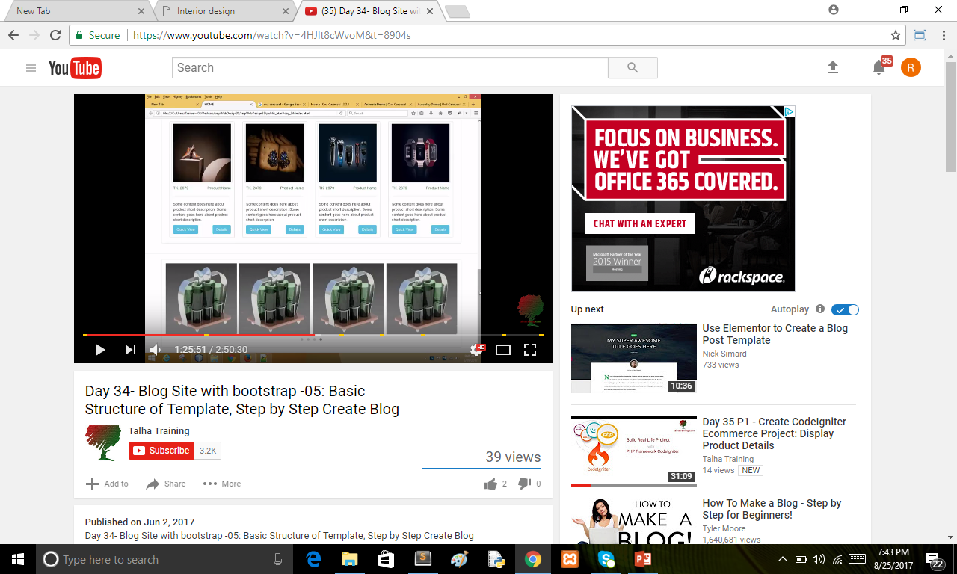

Slide 2
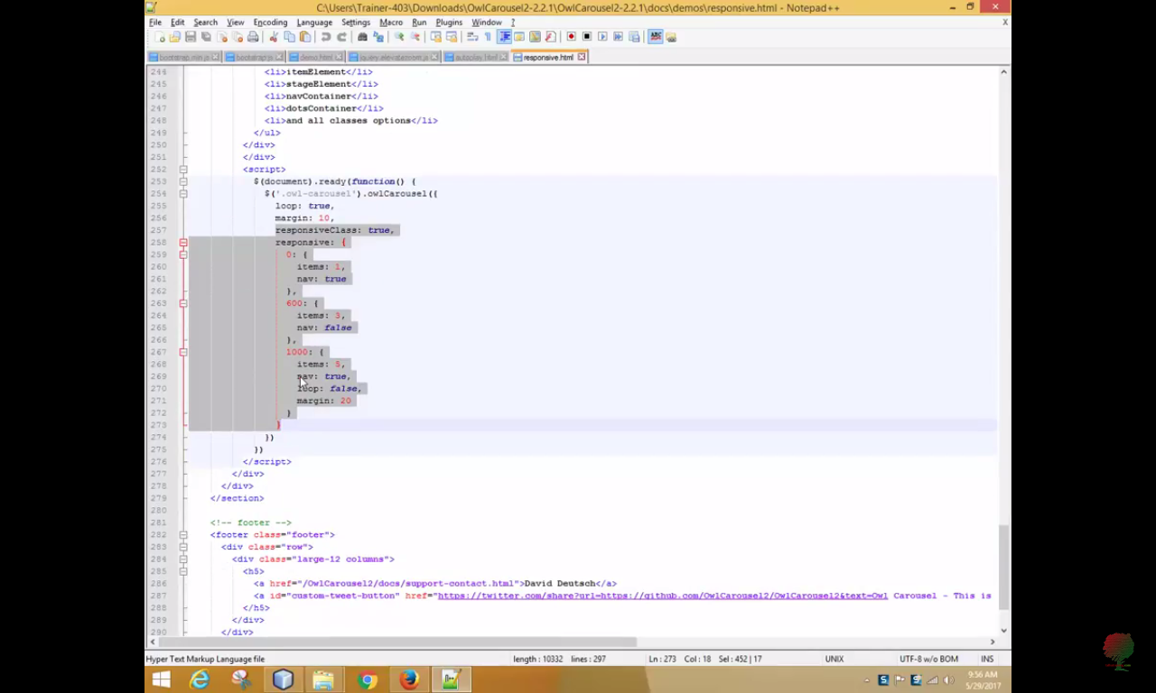

Slide 3
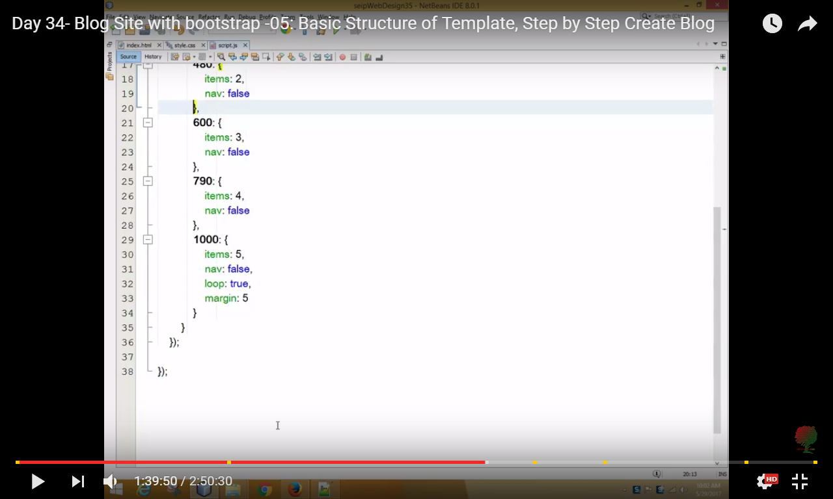
Nav : false

Slide 4
We are changed the responsive limit 0, 480, 480-600, 600-790,790-1000 and change the loop true

